Slide 1
Prestressed concrete slab construction and execution
Name :-mohd adnaan uddin

Slide 2
objective
• Introduction
• Type of prestressed slab
• General design consideration
• presstressted concrete method

Slide 3
intoduction
• Post-tensioned concrete floors form a large proportion of all prestressed concrete construction.
• It is economically competitive with RC slabs in most practical medium- to long-span situations

Slide 4
Methods of Prestressed
Pre-tensioning
Post-tensioning

Slide 5
Pre-tensioning
Pre-tensioning is accomplished by stressing wires or strands, called tendons
To predetermined amount by stretching them between two anchorages prior to placing concrete
The tendons tend to regain their original length by shortening and in this process transfer through bond a compressive stress to the concrete.

Slide 6
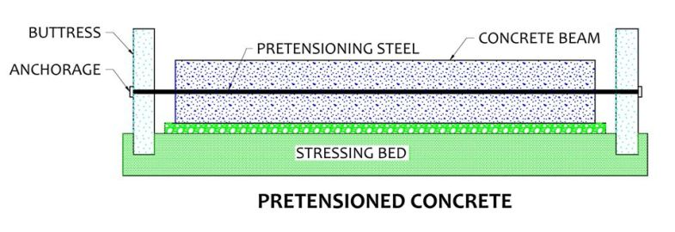
Pre-tensioning

Slide 7
Post-tensioning
The alternative to pre-tensioning is post-tensioning.
In a post-tensioned beam, the tendons are stressed and each end is anchored to the concrete section
After the concrete has been cast and has attained sufficient strength to safely withstand the prestressing force

Slide 8
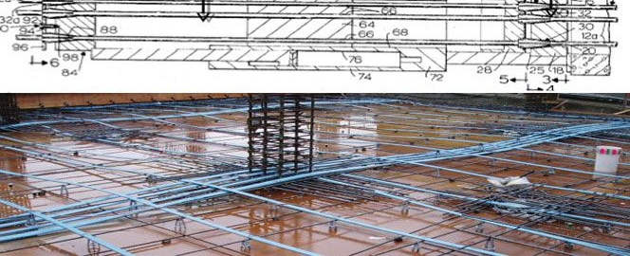
Post-tensioning

Slide 9
Advantages
Deflection better controlled in post-tensioned slab.
Slenderer slab system - increased head room reduced floor to floor heights.
Pre-stressed inhibits cracking will produced crack free and watertight floors.

Slide 10
Disadvantages
It requires high strength concrete and high tensile strength steel wires.
The main disadvantage is construction requires additional special equipment.
It requires highly skilled workers under skilled supervision.

Slide 11
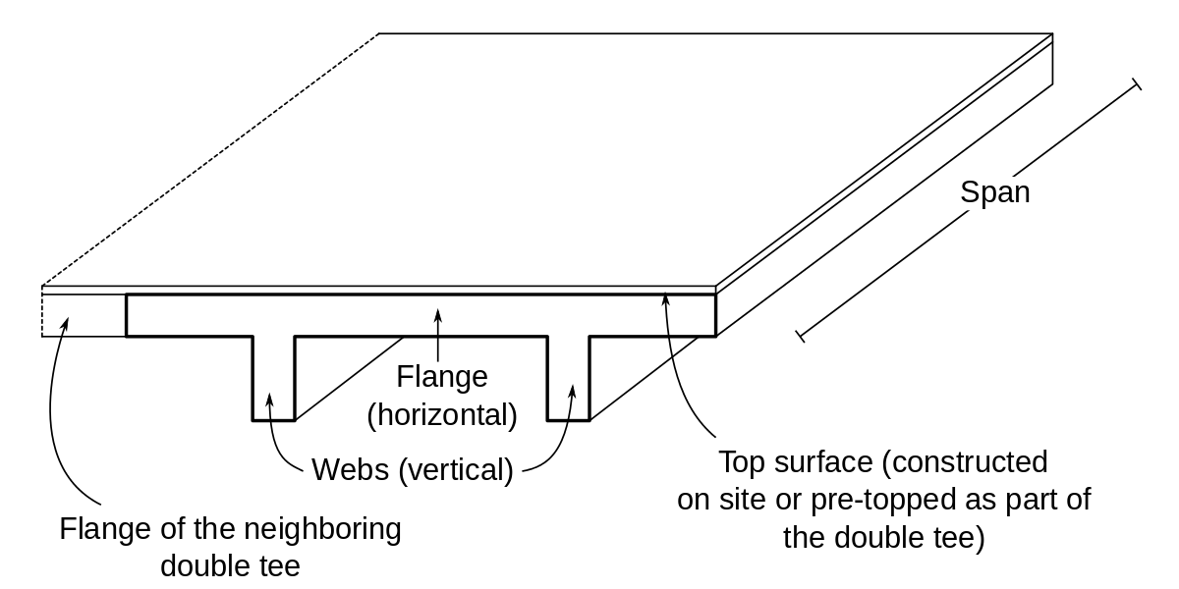
Prestressed concrete slab

Slide 12
conclusion
Thus prestressed concrete incresces the quality strength span of the structure
Cost it is cost effective it is used widely on recent days

Slide 13
Thank you

